Slide 1
10 Output Analysis: Comparing Alternatives
Ref: Law & Kelton, Chapter 10

Slide 2
Introduction: The Problem
You have a system with 3 servers.
You are trying to decide on an appropriate queue arrangement and discipline.
You run a simulation with a common queue for all servers AND one in which each server has a queue.
Given the stochastic nature of the simulation, how do you decide which policy is better?

Slide 3
Introduction: The Problem
Our problem: Policy A may be better than Policy B, but the overlap in the distributions means that we may have difficulty determining this.
True mean
Policy A
True mean
Policy B
System Response
The solution: We will develop a confidence interval for Policy B – Policy A. If the CI does not contain 0, we conclude that the policies are different.

Slide 4

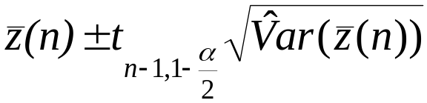
Comparing Two Systems: Paired t
In comparing the performance of two systems, calculate a confidence interval for the difference between the systems’ performance measures:
let z_{1j} = measure of performance of system 1 for replication j
let z_{2j} = measure of performance of system 2 for replication j
then set z_{j} = z_{1j} - z_{2j} for j=1,...,n
and a 100(1-α)% confidence interval is
Interpretation: if the confidence interval includes 0, then there is no significant difference between systems 1 and 2.

Slide 5



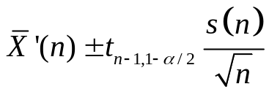
A Note on Var(z(n))
Law and Kelton give the formula for the variance of the estimator as:
and advocate its use in a confidence interval with the following formula:
However, if we consider x’_{j} = x_{1j} – x_{2j} we can use the standard formula for sample variance
and use it to build a standard confidence interval:

Slide 6
Comparing Two Systems...
To construct a good paired-t test, the variance of the difference of the means should be low, therefore the z_{1j}’s and the z_{2j}’s should be highly correlated.
To achieve correlation of the outputs:
the two systems being compared should use the same streams of random numbers
random number streams in the two systems should be used for the same purposes (e.g. one stream for arrivals, another for service times)
service times can be generated at arrival and stored in an attribute of the arriving entity, so that corresponding arrivals in the two systems have the same arrival and service time random numbers
The number of data points for both systems must be the same.

Slide 7
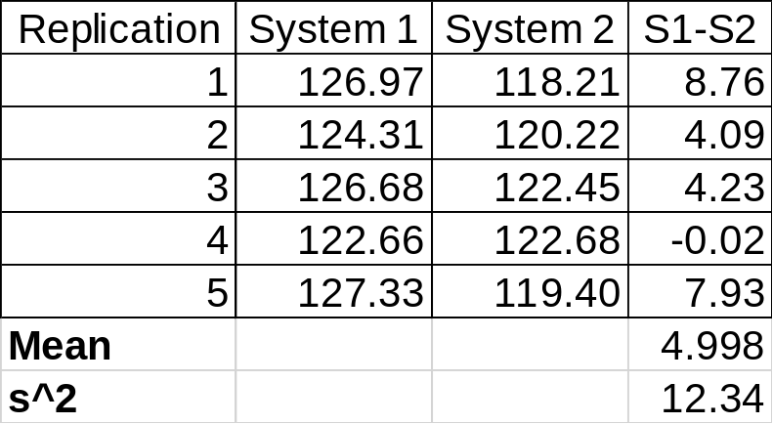
Example 10.3
Assume we are comparing two systems and would like a 90% confidence interval on S1-S2:
Since this interval does not contain 0, we conclude that the two means are different.
t_{4,0.95} = 2.13
CI = 4.998 +/- 2.13(12.34/5)^{.5}
= 4.998 +/- 3.35
= [1.65, 8.35]

Slide 8
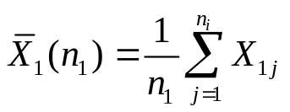
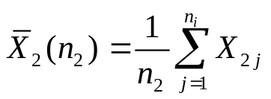
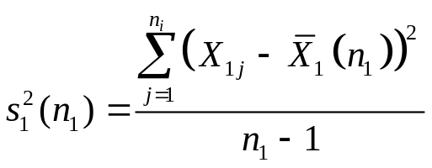
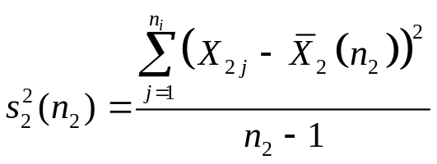
The Modified Two Sample
If, for some reason, we cannot pair observations then we must modify the procedure for calculating the confidence interval.
For each system, calculate the mean in the normal fashion:
For each system, calculate the sample variance in the normal fashion:

Slide 9
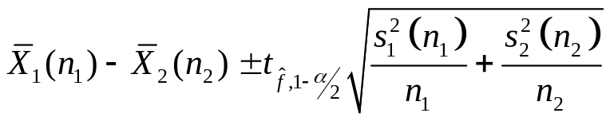
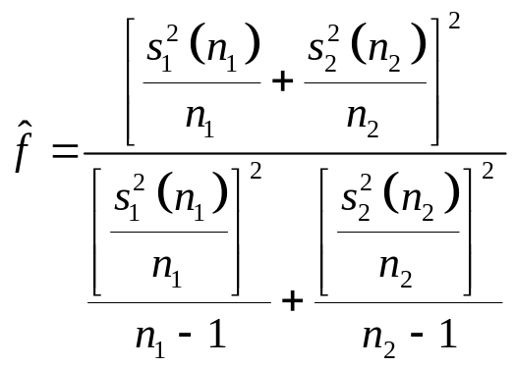
The Modified Two Sample
Build the following confidence interval:
Where the estimated degrees of freedom are given as:
Note: In general this won’t be an integer. We may have to interpolate in the f tables.

Slide 10
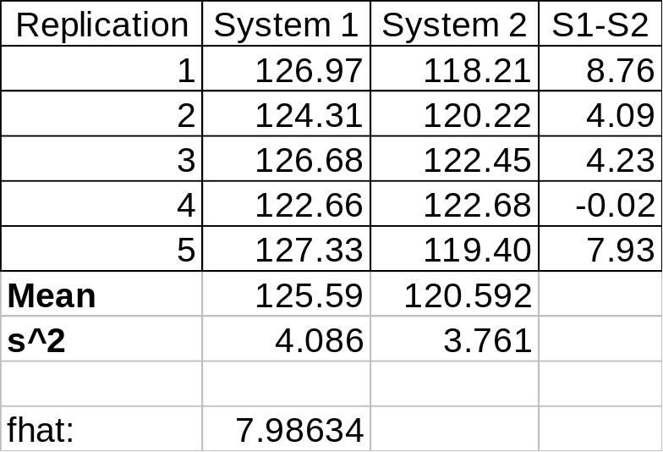
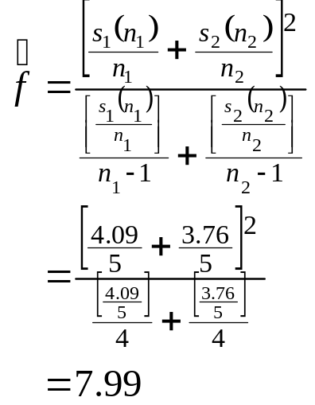
Example 10.3 Revisited
Assume we would like a 90% confidence interval on S1-S2:
t_{7.99,0.95} ~ 1.86
CI = (125.59-120.59) +/- 1.86(4.09/5 + 3.76/5)^{.5}
= 4.998 +/- 1.86(1.25)
= [2.66, 7.30]
Since this interval does not contain 0, we conclude that the two means are different.

Slide 11
Comparing More than Two Systems
We wish to compare k systems.
  The comparison between any two of them is the same as before.
  However, we need to distinguish individual confidence levels and overall confidence level.
Comparison with a standard
  We compare systems 2, 3, …, k to the standard system 1.
  We construct confidence interval for differences: μ₂ - μ₁, μ₃ - μ₁, …, μ_{k} - μ₁.
  To achieve overall confidence level (1-α)%, the confidence level of individual difference should be (1-α/(k-1))%, since we will be making k-1 comparisons
All pair-wise comparison
  We compare any two systems from 1, 2, …, k.
  There are in total k(k-1)/2 pairs of systems.
  To achieve overall confidence level (1-α)%, the confidence level of any individual difference should be (1-α/((k-1)k/2))%, since we will be making (k 2) comparisons.

Slide 12
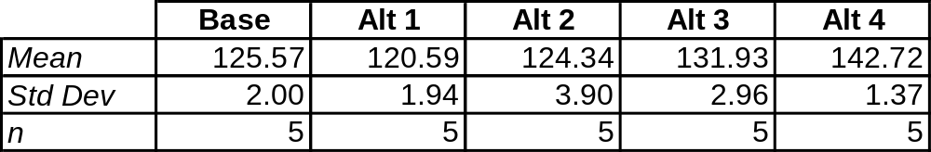
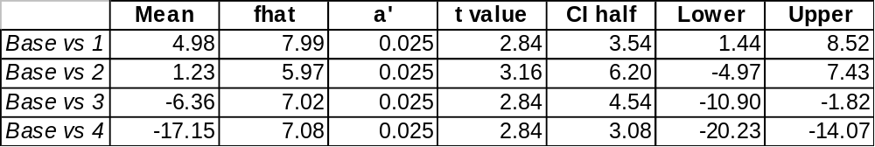
Standard Comparison Example
Assume we have four alternatives to compare against a base case and we want to compare our overall level of confidence to be α = 0.1.
We will make 4 comparisons, thus α’ = 0.025
Assume we have the following data:
Using the non-paired test from our last slide we develop CI’s for all pairs.
This comparison suggests that alternatives 1 and 4 are significantly different from the base case.

Slide 13
Selecting the best of k Systems
This is a two-stage sampling method.
Let X_{ij} be the measure of performance of the j^{th} run of the i^{th} system.
We assume that all X_{ij}’s are independent and that μ_{i} = E(X_{ij})
Let μ_{il} be the l^{th} smallest μ_{i}: i.e. μ_{i1} ≤ μ_{i2} ≤ ...
Our goal is to identify μ_{i1}
Let CS mean “correct selection”
We need to pre-specify P(CS), the probability of correct selection:
P(CS) ≥ P*, where P* > 1/k (i.e. better than guessing!)
We also specify the indifference amount d* where μ_{i2} - μ_{i1} ≥ d*
d* is the largest difference between the means of any two systems which we do not consider to be important.

Slide 14
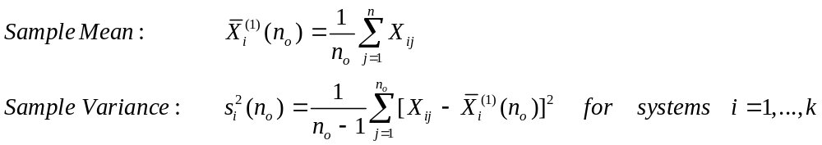
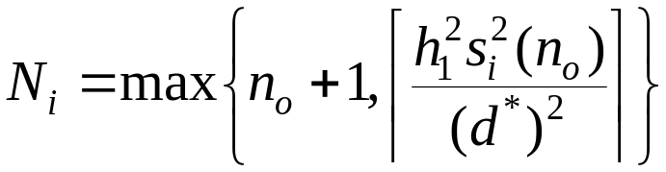
Selecting the best of k Systems...
Stage I:
(1) make n_{o} runs of each system, n_{o} ≥ 2 (preferably ~ 20), and calculate:
(2) compute the total sample (run) sizes N_{i} for i=1,...,k:
Where h₁ (which depends on k, P*, and n₀) comes from a table in App 10.B

Slide 15
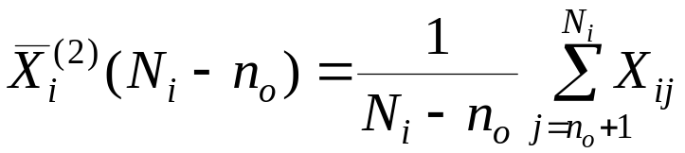
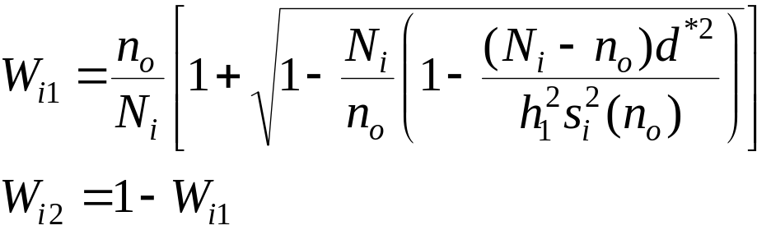
Selecting the best of k Systems...
Stage II:
(1) make N_{i} - n_{o} more runs of each system, and calculate:
(2) calculate weights for each system (W_{i1} and W_{i2}) as follows:

Slide 16

Selecting the best of k Systems...
Conclusion:
(1) Calculate the weighted sample means:
(2) select the system with the smallest value of
Notes:
use n_{o}≥20
choose P* as small as possible and d* as large as possible to keep the number of runs small.

Slide 17
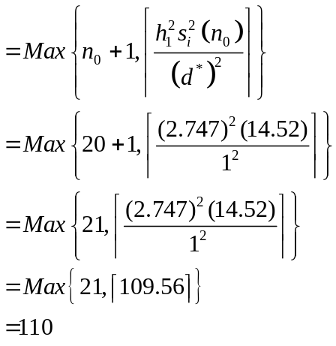
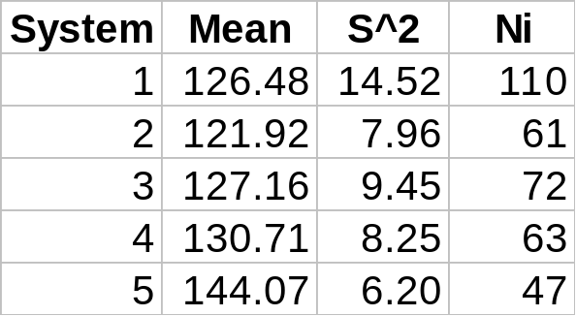
Example 10.8
Consider the following k=5 simulated inventory policies.
We wish our confidence level to be 100P* = 90 (i.e. P* = .9) and we will use d* = 1 as the indifference amount.
We have conducted an initial run with n₀ = 20 for each system
From table 10.11 our h₁ value is 2.747

Slide 18
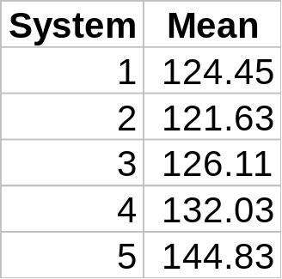
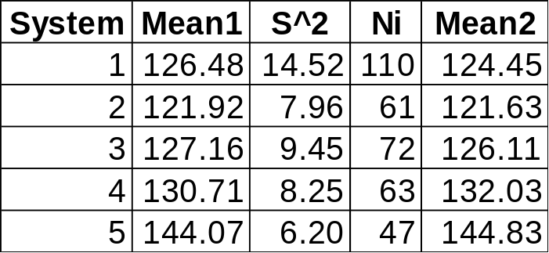
Example 10.8
We carry out the additional runs suggested in our last calculation and get the following sample means from this second set of runs
Using this data and the data from the previous slides, we can calculate a weight for each of the two sets of runs.

Slide 19
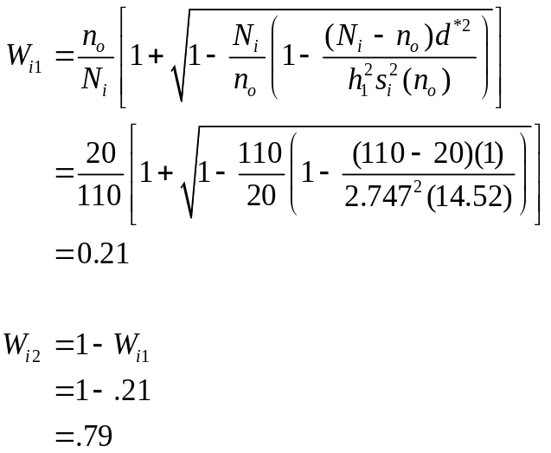
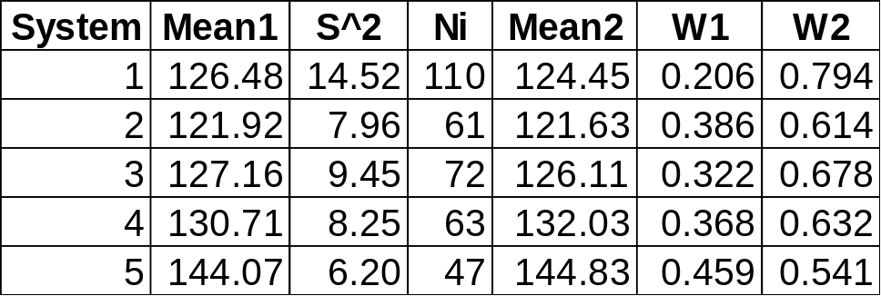
Example 10.8

Slide 20
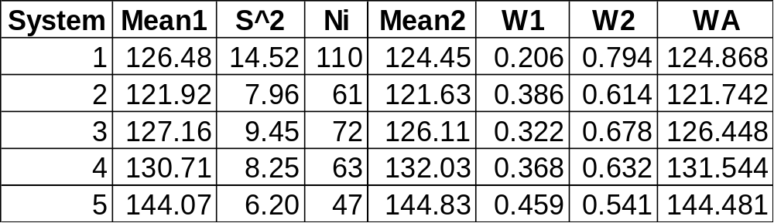
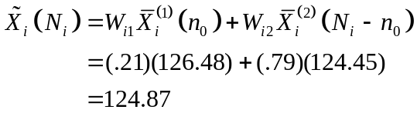
Example 10.8
Finally, using these weights, we can calculate a weighted average for our systems:

